Slide 1
Data visualization
Presentation 1
Group 5

Slide 2
Traffic accident data from US and UK
Overview of datasets
FARS (Fatality Analysis Reporting System)
NHTSA (National Highway Traffic Safety Administration)
Data Type
Multivariant, Temporal (1982-2017), Geospatial (10 regions)
Size of dataset
1,3 million items, 67 dimensions (Accident, Person, Vehicle)
390MB (CSV file)
Road safety data
Department for transport
Data Type
Multivariant, Temporal (2005-2015), Geospatial (941 regions)
Size of Data
1,7 million items, 66 dimensions (Accident, Person, Vehicle)
544MB (CSV file)

Slide 3
Potential users
Insurance company (focus on one country)
Determine price of car insurance (Age, Region, Car type…)
Public service
Awareness of most likely cause for traffic accident (DANGER!! Scare the public)
Legislative agencies
Compare countries (Look at traffic law and find trends in country)

Slide 4
Idea – comparison of country
User
Legislative agencies
Data cleaning
Both dataset must range from 2005-2015
Both dataset must only involve fatal accidents
Choose common parameters for both datasets
Purpose
Compare different aspects of accidents in a detailed manner
Find clear difference in accidents

Slide 5
Idea – accidents only in UK
User
Insurance company
Data cleaning
Select interesting parameters to investigate
Purpose
Find high risk groups (accident)
Help determine insurance price

Slide 6
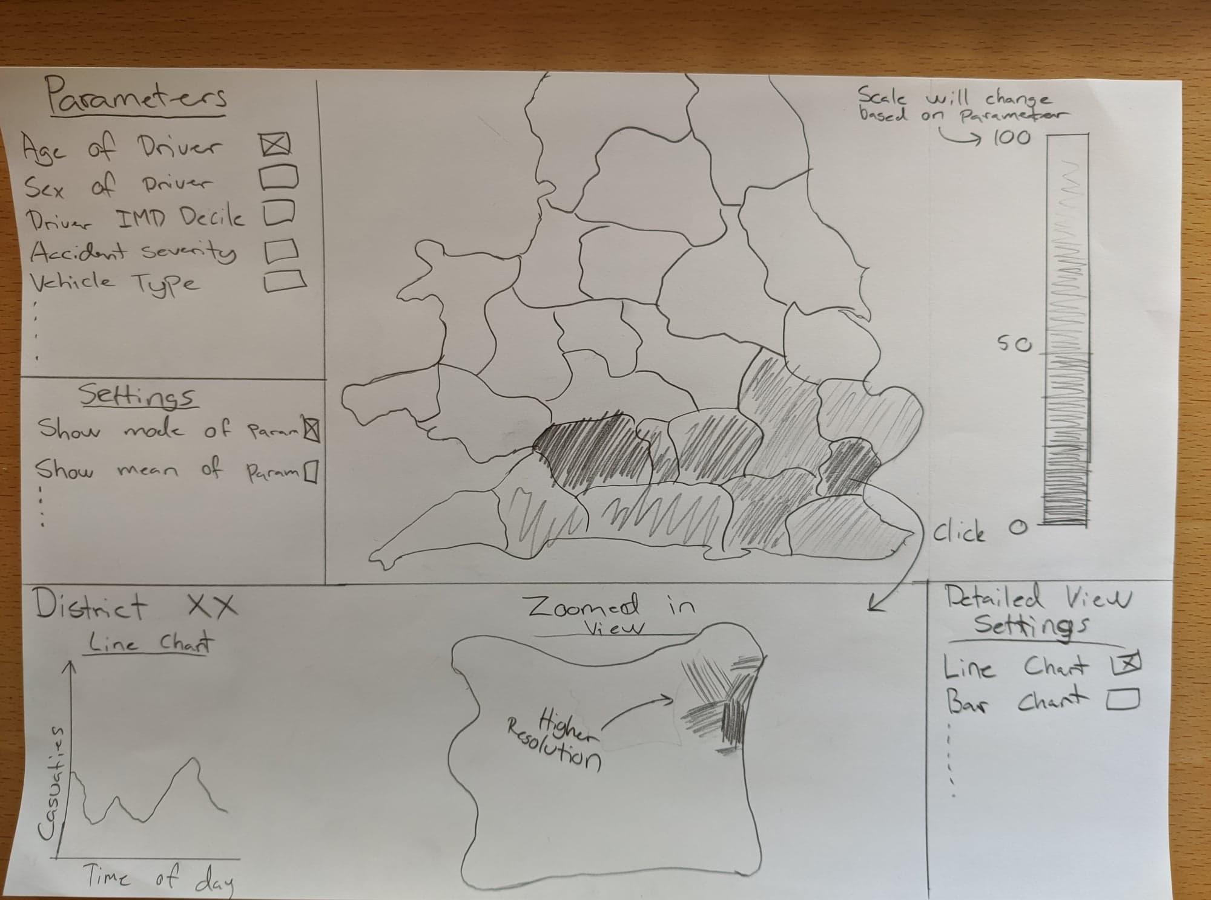

Slide 7
